Slide 1
Advertising
A Brief History of the Creation and Manipulation of Consumers

Slide 2
Advertising
An attempt to persuade an audience to purchase a good or service, make a contribution, cast a vote
aims to win sales, gain attention, or stimulate interest in hopes that purchases will follow
Repetitive ads for familiar products often aim to short-circuit the conscious consideration of purchase decisions- you’ll buy what they say you’ll buy because you’re so familiar with it.

Slide 3
Advertising is about…
Manipulating you into believing you have some sort of need, weakness, flaw, or deficiency that a product or service can satisfy, alleviate, make better, or supplement.
Convincing you of a particular brand’s integrity or reputation.
Controlling the commodities a consumer will purchase in order to support the economic system.
Notes:
Just as there is a market for popular culture, popular music, popular art, there is a market for counter culture, alternative culture, religious culture, educational culture. EVERYTHING is about money. In order to make money, manufacturers, corporations, corner coffee shops, the people at Lake Ella who braid friendship bracelets, need you to think that you are in need of their product or service. With every purchase we make- groceries, jeans, braided friendship bracelets, we are identifying ourselves (showing a persona) as part of a certain community. We would all like to think that these communities mean something. But in advertising, they all mean money. So, for advertisers and marketers, there is no real difference between the counter culture of Marilyn Manson and the popular culture of Britney Spears. The thing you are buying is irrelevant. You are buying, and that is good.

Slide 4
Who decides?
“People know what they want because they know what other people want.”
-Theodor Adorno (Sociologist/ Philosopher/ Popular Culture Analyst)
You are being manipulated 100% of the time.
Advertisers and manufacturers direct you towards the things they want you to want, the things manufacturers are manufacturing.
Notes:
Ex: Radio programming does not play the most popular songs. It plays the songs that will target the audience of their advertisers. This makes advertisers remarkably powerful. We can certainly point to the FCC as far as media censorship, but if Walmart pays for commercials during a certain section of programming on tv or radio, or has an add in a magazine, or during a television show, it may threaten to pull ads (money) from the network if it shows programming that Walmart deems “offensive”. Since the network’s bills are paid through that advertising, it MUST ensure that Walmart continues to advertise.

Slide 5
Popular Debates in Advertising Analysis
Are advertisers trying to persuade you or control you?
Who controls what you purchase (implication: Who chooses what you like?)?
https://www.youtube.com/watch?v=vL-KQij0I8I

Slide 6
Early Advertisements
Announcements of “goods on hand” in newspapers
Advertisements for runaway or captured slaves
Both included persuasive appeals to perceived needs or ideology of colonists.
Notes:
Historians have used these advertisements (slave capture/ escape) as sources to examine tactics of resistance and escape, to study the health, skills, and other characteristics of enslaved men and women, and to explore slaveholders’ perceptions of the people they held in bondage. In order for historians to do this, they close read the advertisement.

Slide 7
20 Dollars Reward RAN AWAY from the subscriber, living in the Jowes end of Hanover, about the 10th day of May last, a tall straight, black Negro Woman, by the name of POLLY; about 24 or 25 years of age, with large, heavy, white eyes, speaks very fast when a little agitated, and has sustained a small injury to the end of the middle finger of her right hand by a whitlow.
Notes:
Reading the content of this slave advertisement, it is easy to see how historians would be able to use this for their research into the culture.

Slide 8
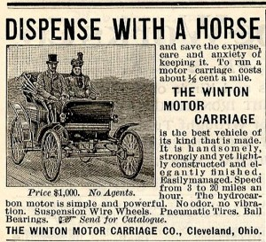
Magazines
Early publications segregated ads to the very back of the magazine. All ads appeared in black and white.
This ad appeared in 1898 in Scientific American magazine.
Notes:
This is the first known automobile advertisement printed in a magazine. We could close read the hek out of it for persuasive and manipulative language. Besides the language, the other important aspect of this advertising tactic is that a reader would have to flip to the advertisements in order to encounter one.

Slide 9
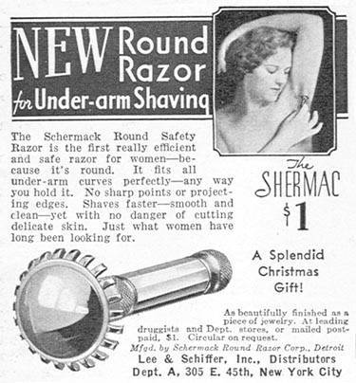
Turn of the 20th Century, the introduction of new production techniques created standardized products in unheard-of quantities, and sought to find and persuade buyers.
Notes:
Manufacturing techniques for products created the need for consumers. Consumer demand did not. More products made= more buyers needed. Essentially, manufacturers look for any reason to promote their product. Advertisers now try to create consumers, rather than just sell a product with persuasive language. EXAMPLE: 1915- sleeveless dresses become fashionable because designers and manufacturers market them to the “upper crust” of society. The vulnerability women were made to feel? Hairy armpits are a deficiency. From this, women began shaving their underarms, which led the way for manufacturers to make more razors and suggest that leg shaving is also necessary because body hair is a “weakness.” The new fashions were an “excuse” of sorts for the manufacturers to boost production and focus advertising on women.

Slide 10
Sears, Roebuck & Co. 1930 and 1940 respectively

Slide 11
Sears, Roebuck & Co. 1930s
Manipulation is never just for the ladies.
Men are also introduced to “must haves” that promise a lifestyle or persona.

Slide 12
Television
1960’s= “The Golden Age”
Ownership of TV sets grows and becomes status quo.
Television becomes a new medium for advertising with new possibilities for identifying and isolating audiences, ( ie: creating consumers).
Notes:
This is called the Golden Age of television because of the shift to this medium as a primary form of entertainment within the majority of households. A new way to dupe the masses! Remember the creation of a consumer involves advertisers making you feel deficient in some way or in need of something in order to truly be what you want to be. And that thing you want to be is mostly a construct made for you by the advertisers.

Slide 13
Audience RULES!
Target Audience- the group who watches the show that happens around the commercials
Advertising (and networks to a lesser degree) controls the flow of television programming.
–Flow- Shows and commercials aired during those shows during certain blocks of time.
18-34 year-olds (one target audience) are statistically the best buyers.
Notes:
“Flow” is a technical term in television production. Since the 1960s programming has come to include seemingly every possible demographic. There’s a show for everyone whether you like popular culture, counter culture, religious programming, educational programming, etc.; whether you are young, middle-aged, over-the-hill; whether you are black, white, asian, hispanic, Icelandian, etc. Think about the number of channels we have, the different types of networks and programming available. “Flow” refers to the time, order, type of programming available including advertisements. Why is this important to know about? The 18-34 year-old demographic are statistically the best consumers in the United States. TV shows during “prime time” are supposed to appeal to them the most. In order to do that, producers must consider who the network advertisers are and what type of message they need to send to which target audience, etc. If a show is popular with the 74-90-year-old crowd, it will probably be canceled, or at least moved to a new day & time, due to the fact that those people are not good consumers. 18-34s will purchase products for kids, friends, parents, grandparents more indiscriminately. So, Friends became popular in the 90s because it sold a lifestyle to 18-34 year olds. It created an audience that would be entertained by the show long enough to put up with the commercials that sold a similar lifestyle. It gets even more complicated when you consider that there are only 6 corporations in control, two of which are run by the same people. Each of those CEOs also sits on the board of directors for at least one other manufacturing/ marketing company. So, if a board member from Time Warner is also on the board of Federal Express or Delta airlines (or both), it is in THAT person’s best interest to target an audience that will buy those products and services provided by those companies. It gets conspiracy theory-ish. Check out theyrule.net. It’s an old site, but it demonstrtes the issue.

Slide 14
Audiences are created.
Example of target audience shift- 1955- The Leo Burnett agency revamped advertising for Marlboro cigarettes, formerly a minor brand marketed for their mildness and aimed at women smokers. Burnett introduced the Marlboro Man, models of rugged cowboys on horseback, smoking “a cigarette designed for men that women like.”
Lesson: An audience will be created for a product.
Men didn’t choose Marlboro, it was chosen for them.
Notes:
The tobacco company wasn’t selling the cigarette. It was selling the persona of the rugged, cowboy, wearing blue jeans and a stubbly beard.

Slide 15
Other places you are targeted…
Facebook “likes.”
Twitter posts.
Instagram likes.
Netflix binges.
Amazon purchases.
Google searches.
All of these things determine the ads that get sent to these accounts when you are using them.

Slide 16
Next time you watch TV…
Notice the types of shows that are on during a specific time.
Notice the commercials during those shows. What are they for? How are they presented?
What group did the advertisement try to reach? On which network did the ad appear? With what kind of viewer?
What point of view is being presented in the flow?
Notes:
The entire 3 hour block, for example, is selling a persona. It’s telling you about who you want to be AND giving you the tools (products) you need in order to achieve “your” goals.

Slide 17
Next time you read a magazine…
What type of ads are found in the magazine?
Are the ads in the front or back of the magazine different in some way?
By what type of content is the ad surrounded?
Who reads this magazine?

Slide 18
How To Read Images

Slide 19
Close Reading a Different Kind of Text
Just as close reading written text can be simplified by knowing what to look for, reading images is easy when you have a practiced set of skills.
When close reading images, think about the image’s composition (layout), colors, and the angles of the images.

Slide 20
Layout
Images can be divided into foreground, midground, and background. What does the artist put in each of these places? What ideas or elements are emphasized as a result?
Are images in the background or foreground clear or blurred? Is the midground dwarfed by the space devoted to the background or foreground? How does this composition emphasize or minimize different elements?
Is there any text matched with the image? If so, how? What does the placement of the text add to the meaning of the image overall?

Slide 21
Colors
We associate different colors with different feelings. These aren’t set in stone, but they follow standard, predictable patterns. Also consider combinations of color. What emotions/ feelings do you connect with these colors?
Red-
Green-
Blue-
Yellow-
Pink-

Slide 22
Angles
Are the images coming toward or moving away from the viewer?
To what extent do the images fill the frame?
What is the relationship between the viewer and the angle of the image?
Are the figures in the image looking directly at the viewer, or slightly away? How does this define the relationship between image and viewer?

Slide 23
Practice

Slide 24
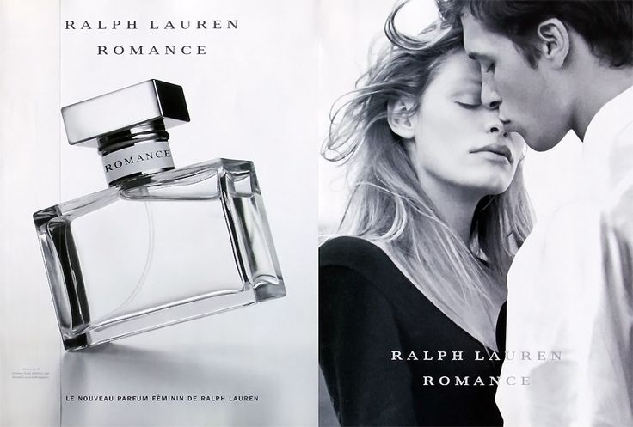

Slide 25
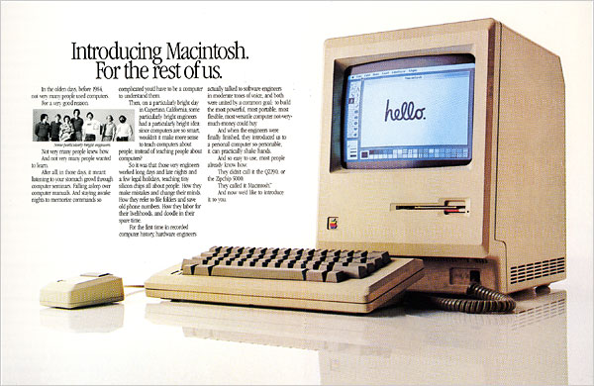

Slide 26
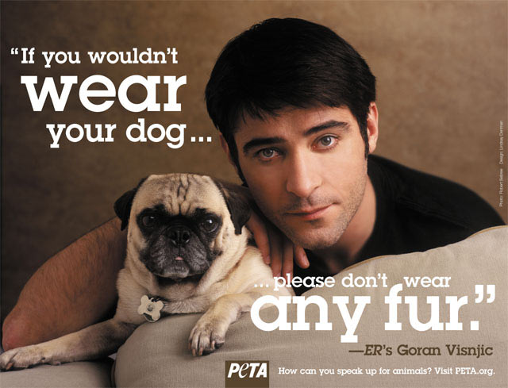

Slide 27
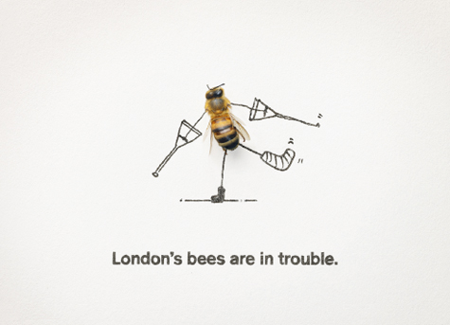

Slide 29
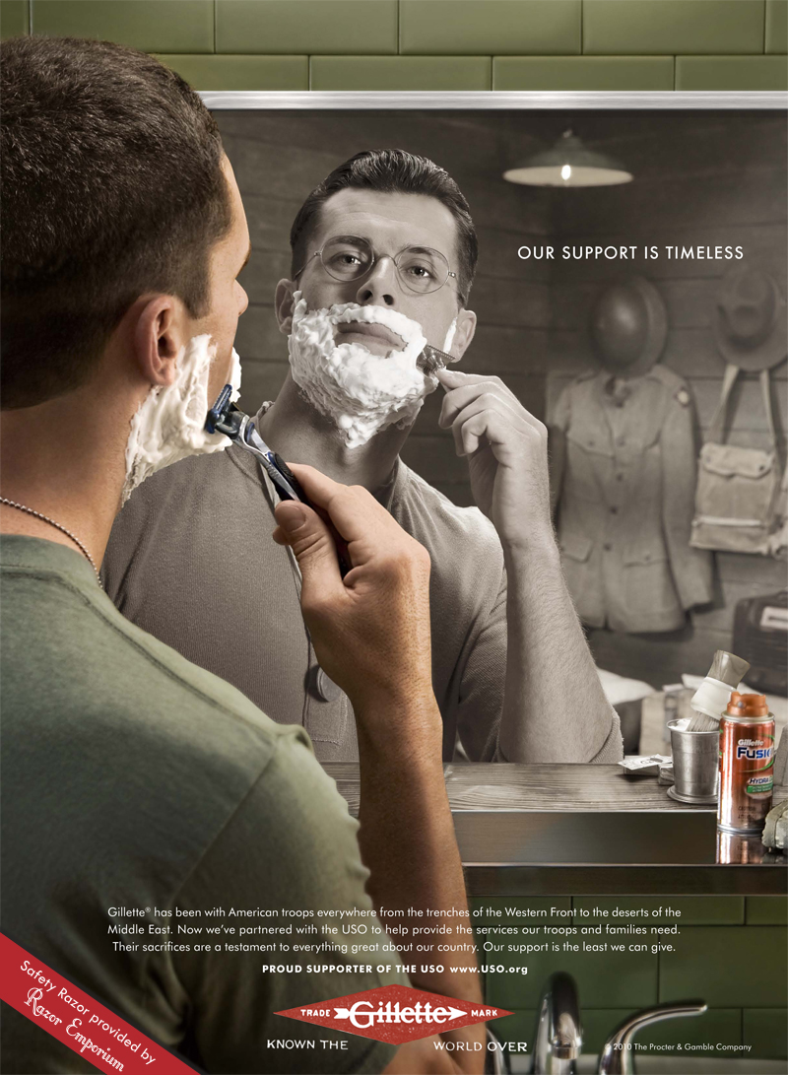

Slide 31
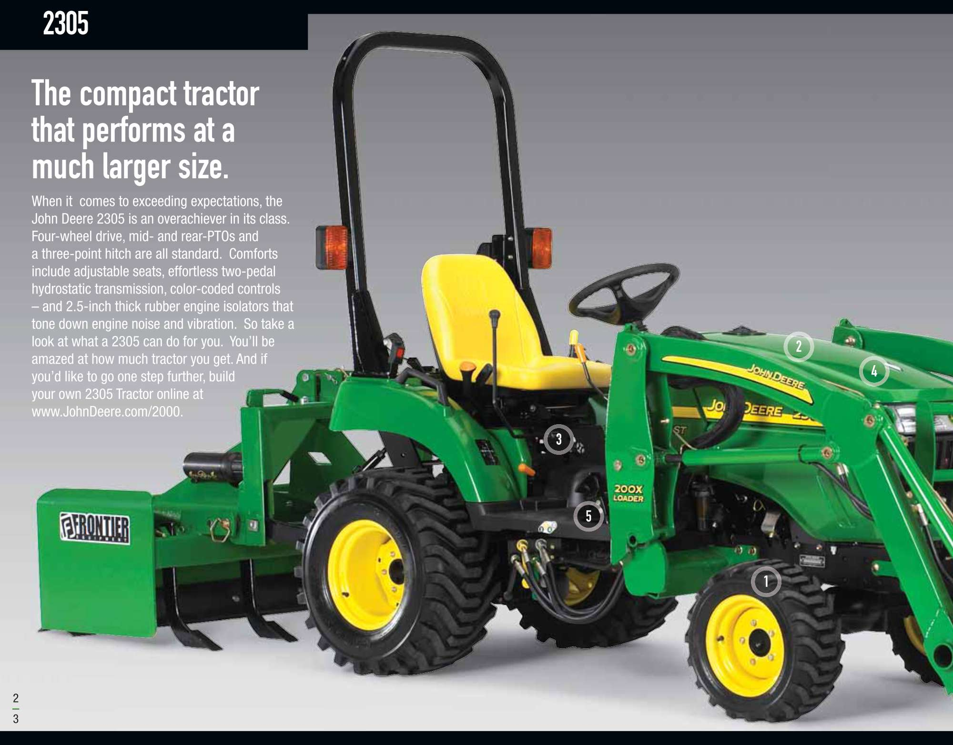

Slide 33
November 1956

Slide 34
Rolex

