Slide 1
MLA Formatting
2018

Slide 2
What is MLA formatting?
MLA (Modern Language Association) style formatting is often used in various humanities disciplines.
MLA regulates:
Document Format
In-text citations
Works Cited (a list of all sources used in the paper)

Slide 3
General Guidelines
Type on white 8.5“ x 11“ paper
That’s just the standard, letter-sized paper!
Double-space everything
Use 12 pt. Times New Roman font
Or whatever the default font is on your word processing program
Leave only one space after punctuation
Set all margins to 1 inch on all sides
Indent the first line of paragraphs one half-inch
That’s just the Tab button

Slide 4
General Guidelines
Header with your last name and the page numbers in the upper right corner
Use italics for titles
Works Cited is a separate page at the end of your paper
No title page

Slide 5
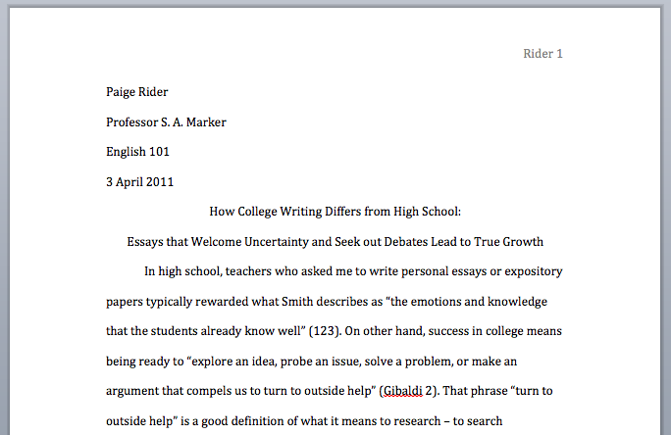

Slide 6
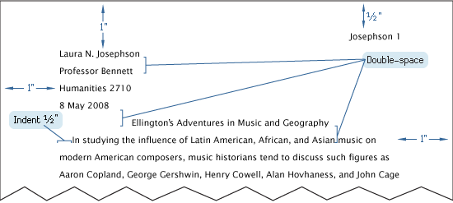

Slide 7
The First Page
Your header goes ½ inch down on the right side and includes your last name and the page number
No comma between them
In the upper left corner, list your name, your instructor's name, the course, and date
The date is written in the European style: Day Month Year
Center the paper title
Use standard caps but no underlining, italics, quote, or bold
Size 12 font
Come up with a good title—not just the name of the assignment

Slide 8
In-Text Citations
MLA uses parenthetical citations
Parenthetical citations depend on the medium
e.g. Print, Web, DVD
Parenthetical citations also depend on the source’s entry on the Works Cited page
Your citation entry must match your Works Cited entry
Signal word in the text is the first thing in the corresponding entry on the Works Cited page
Your parenthetical citation must include the author’s last name and the page number
No comma or punctuation between
If you name the author in the sentence your quote is embedded in, you do not need to list the author’s name in the citation, only the page number
CITE EVERYTHING!!

Slide 9
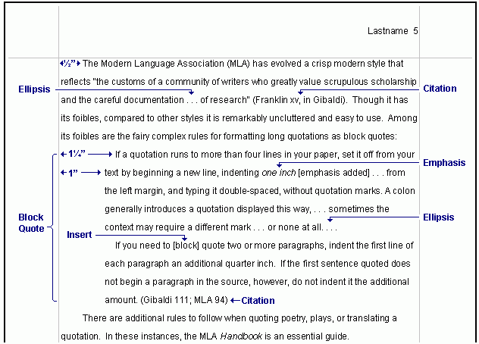

Slide 10
Citations: Print Source with an Author
In-text Example:
Wordsworth stated that Romantic poetry was marked by a “spontaneous overflow of powerful feelings” (263). Romantic poetry is characterized by the “spontaneous overflow of powerful feelings” (Wordsworth 263)
Wordsworth extensively explored the role of emotion in the creative process (263).
Corresponding Works Cited Entry:
Wordsworth, William. Lyrical Ballads. London:
Oxford UP, 1967. Print.

Slide 11
Citations: Print Sources with an Unknown Author
In-text Example:
We see so many global warming hotspots in North America likely because this region has “more readily accessible climatic data and more comprehensive programs to monitor and study environmental change ...” (“Impact of Global Warming” 6).
Corresponding Works Cited Entry:
“The Impact of Global Warming in North America.” Global Warming: Early Signs. 1999. Web. 23 Mar. 2009.

Slide 12
Other Citations
Classic & Literary Works with Multiple Editions
In-text Example:
Marx and Engels described human history as marked by class struggles (79; ch. 1).
Authors with Same Last Names
In-text Example:
Although some medical ethicists claim that cloning will lead to designer children (R. Miller 12), others note that the advantages for medical research outweigh this consideration (A. Miller 46).

Slide 13
Other Citations
In-text Examples:
Smith, Yang, and Moore argue that tougher gun control is not needed in the United States (76).
The authors state “Tighter gun control in the United States erodes Second Amendment rights“ (Smith, Yang, and Moore 76).

Slide 14
Other Citations
Multiple Works by the Same Author
In-text Examples:
Lightenor has argued that computers are not useful tools for small children (“Too Soon” 38), though he has acknowledged elsewhere that early exposure to computer games does lead to better small motor skill development in a child's second and third year (“Hand-Eye Development” 17).
Visual studies, because it is such a new discipline, may be “too easy” (Elkins, “Visual Studies” 63).

Slide 15
Other Citations
Film
In-text Example:
Werner Herzog's Fitzcarraldo stars Herzog's long-time film partner, Klaus Kinski. During the shooting of Fitzcarraldo, Herzog and Kinski were often at odds, but their explosive relationship fostered a memorable and influential film.
Corresponding Works Cited Entry:
Herzog, Werner, dir. Fitzcarraldo. Perf. Klaus Kinski. Filmverlag der Autoren, 1982. Film.

Slide 16
Other Citations
Sources from the Internet
In-text Example:
One online film critic stated that Fitzcarraldo is “...a beautiful and terrifying critique of obsession and colonialism” (Garcia, “Herzog: a Life”).
Corresponding Works Cited Entry:
Garcia, Elizabeth. “Herzog: a Life.“ Online Film Critics Corner. The Film School of New Hampshire, 2 May 2002. Web. 8 Jan. 2009.

Slide 17
Formatting Short Quotations
According to some, dreams express “profound aspects of personality” (Foulkes 184), though others disagree.
According to Foulkes's study, dreams may express “profound aspects of personality” (184).
Is it possible that dreams may express “profound aspects of personality” (Foulkes 184)?
Cullen concludes, “Of all the things that happened there / That's all I remember” (11-12).

Slide 18
Formatting Long Quotations
Nelly Dean treats Heathcliff poorly and dehumanizes him throughout her narration:
They entirely refused to have it in bed with them, or even in their room, and I had no more sense, so, I put it on the landing of the stairs, hoping it would be gone on the morrow. By chance, or else attracted by hearing his voice, it crept to Mr. Earnshaw's door, and there he found it on quitting his chamber. Inquiries were made as to how it got there; I was obliged to confess, and in recompense for my cowardice and inhumanity was sent out of the house. (Bronte 78)

Slide 19
Formatting Quotes: Adding and Omitting Words
In-text Example for Adding Words:
Jan Harold Brunvand, in an essay on urban legends, states: “some individuals [who retell urban legends] make a point of learning every rumor or tale” (78).
In-text example for Omitting Words:
In an essay on urban legends, Jan Harold Brunvand notes that “some individuals make a point of learning every recent rumor or tale . . . and in a short time a lively exchange of details occurs” (78).

Slide 20
Works Cited
This will be the last page of your paper and will follow the same number pattern of the rest of the paper
The header of this page will be the same as the rest of your paper
Title the page Works Cited in standard capitalization, size 12 font, with no special formatting
Each entry will be flush left with the second and subsequent lines indented ½ inch
Do not number your entries
All entries go in alphabetical order of the author’s last name

Slide 21
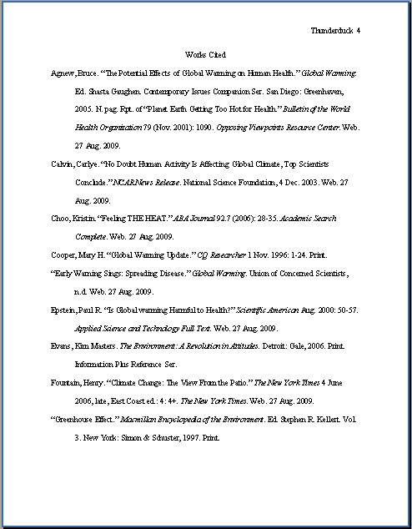

Slide 22
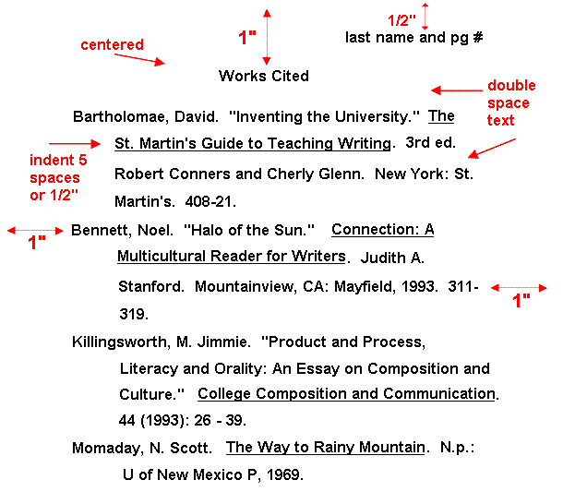

Slide 23
Works Cited
Books
Lastname, Firstname. Title of Book. Place of Publication: Publisher, Year of Publication. Medium of Publication.
Article in a Magazine Format
Author(s). “Title of Article.” Title of Periodical Day Month Year: pages. Medium of publication.
Article in Scholarly Journal Format
Author(s). “Title of Article.” Title of Journal Volume.Issue (Year): pages. Medium of publication.

Slide 24
Works Cited
Web Source Format:
Editor, author, or compiler name (if available). “Article Name.” Name of Site. Version number. Name of institution/organization affiliated with the site (sponsor or publisher). Date of last update. Medium of publication. Date of access.

Slide 25
For More Information
The Purdue OWL http://owl.english.purdue.edu
Cornell University Library MLA Citation https://www.library.cornell.edu/research/citation/mla

